Slide 1


CONTENT
Introduction of Operating System
Windows vs. Linux
1.0 - Security and Stability
2.0 - Operation performance
prepared by Group 1:
On Wu Xu 2290113-DCS
Lim Yee Jie 2290025-DCS
Yap Kah Seng 2290146-DCS
Huai Zi Yao 2290085-DCS
Tan Thee Wei 2290107-DCS
Lee Mun Hinn 2270117-DCS
3.0 - Market Compatibility
4.0 - UI Interface/User Experience
5.0 - Open source & closed source
6.0 - Application scenarios

Slide 2
Windows vs. Linux
CONTENT
Security and Stability
Security and Stability
1.0 - Security and Stability
2.0 - Operation performance
3.0 - Market Compatibility
4.0 - UI Interface/User Experience
5.0 - Open source & closed source
6.0 - Application scenarios
prepared by Group 1:
On Wu Xu 2290113-DCS
Lim Yee Jie 2290025-DCS
Yap Kah Seng 2290146-DCS
Huai Zi Yao 2290085-DCS
Tan Thee Wei 2290107-DCS
Lee Mun Hinn 2270771-DCS

Slide 3


1.0 - Security and Stability
2.0 - Operation performance
3.0 - Market Compatibility
Operating Performance
Windows vs. Linux
CONTENT
Security and Stability
Debug Speed
Linux:
Linux is open source and entire user base has access to the source code. So, when there is a problem with the system, the user can fix it instantly.
Windows:
When there is a problem with the system, the user can only give feedback to Microsoft and wait for them to fix the problem.
Privileges
Linux:
Linux has clearly defined privileges at multiple levels, thereby restricting access.
Windows:
In Windows, the users have full admin access over the accounts. Thus, when a virus attacks the system, it quickly corrupts the whole system.
4.0 - UI Interface/User Experience
5.0 - Open source & closed source
6.0 - Application scenarios
Notes:
https://zhuanlan.zhihu.com/p/38316760 https://linuxsecurity.com/features/how-secure-is-linux

Slide 4

Security and Stability
Operating Performance
Debug Speed
Linux:
Linux is open source and entire user base has access to the source code. So, when there is a problem with the system, the user can fix it instantly.
Windows:
When there is a problem with the system, the user can only give feedback to Microsoft and wait for them to fix the problem.
Performance comparing of Windows and Linux:
The performance of Windows and Linux varies depending on specific hardware and workloads.
Linux outperforms Windows in some tests, while Windows outperforms Linux in others.
For example, according to InterWorks benchmark, Linux (Intel) averaged 300 seconds to complete a test, while Windows (Intel) averaged 355 seconds.
However, it is important to note that these results are subject to variations based on specific hardware configurations and workloads.
Privileges
Linux:
Linux has clearly defined privileges at multiple levels, thereby restricting access.
Windows:
In Windows, the users have full admin access over the accounts. Thus, when a virus attacks the system, it quickly corrupts the whole system.
Notes:
https://zhuanlan.zhihu.com/p/33927828?utm_id=0

Slide 5


Security and Stability
Operating Performance
Privileges
Linux:
Linux has clearly defined privileges at multiple levels, thereby restricting access.
Windows:
In Windows, the users have full admin access over the accounts. Thus, when a virus attacks the system, it quickly corrupts the whole system.
Performance comparing of Windows and Linux:
The performance of Windows and Linux varies depending on specific hardware and workloads.
Linux outperforms Windows in some tests, while Windows outperforms Linux in others.
For example, according to InterWorks benchmark, Linux (Intel) averaged 300 seconds to complete a test, while Windows (Intel) averaged 355 seconds.
For the extract refresh test, Linux is 10% faster than Windows.
Here are the averages refresh speed:
Linux (Intel) : 300 seconds
Linux (AMD) : 318 seconds
Windows (AMD) : 330 seconds
Windows (Intel) : 355 seconds
For the tsm restart test, the clear winner is Linux.
Here are the average restart times:
Linux (AMD): 320 seconds
Linux (Intel): 329 seconds
Windows (AMD): 521 seconds
Windows (Intel): 540 seconds
However, it is important to note that these results are subject to variations based on specific hardware configurations and workloads.
Notes:
https://interworks.com/blog/2021/02/11/put-to-the-test-is-windows-or-linux-faster/

Slide 6
Operating Performance
Market Compatibility
Reasons why Windows is more popular in the market than Linux.
Market share and historical advantage
User-friendliness
Software compatibility
Hardware compatibility
Technical support and community
HOW TO PROVE?
Software and application support
Game compatibility
Hardware compatibility
File format compatibility
User surveys and feedback
For the extract refresh test, Linux is 10% faster than Windows.
Here are the averages refresh speed:
Linux (Intel) : 300 seconds
Linux (AMD) : 318 seconds
Windows (AMD) : 330 seconds
Windows (Intel) : 355 seconds
For the tsm restart test, the clear winner is Linux.
Here are the average restart times:
Linux (AMD): 320 seconds
Linux (Intel): 329 seconds
Windows (AMD): 521 seconds
Windows (Intel): 540 seconds
Performance comparing of Windows and Linux:
The performance of Windows and Linux varies depending on specific hardware and workloads.
Linux outperforms Windows in some tests, while Windows outperforms Linux in others.
For example, according to InterWorks benchmark, Linux (Intel) averaged 300 seconds to complete a test, while Windows (Intel) averaged 355 seconds.
However, it is important to note that these results are subject to variations based on specific hardware configurations and workloads.
Notes:
https://interworks.com/blog/2021/02/11/put-to-the-test-is-windows-or-linux-faster/

Slide 7
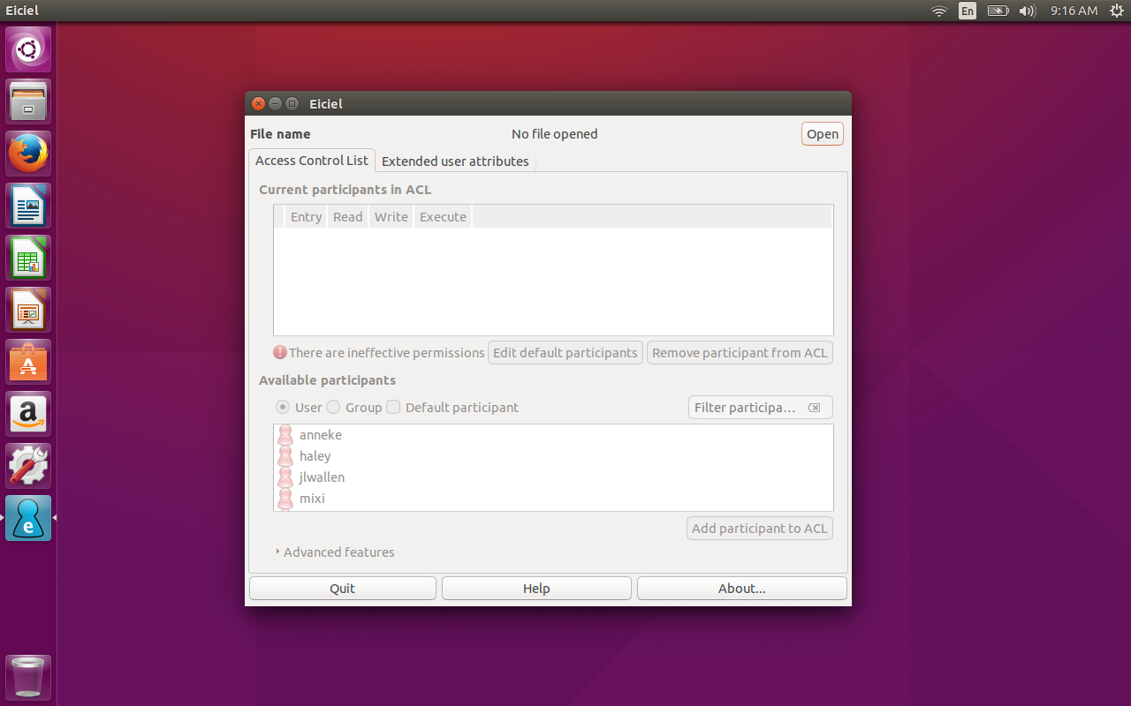
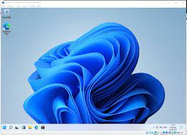
UI Interface/User Experience
Operating Performance
Market Compatibility
provides powerful tools
command-line interfaces for system administration
privacy and data protection are critical
User Friendly Interface and Easy to Use.
Compatible to All Hardware.
Support Plug and Play Feature.
Linux
Reasons why Windows is more popular in the market than Linux.
Market share and historical advantage
User-friendliness
Software compatibility
Hardware compatibility
Technical support and community
Windows
HOW TO PROVE?
Software and application support
Game compatibility
Hardware compatibility
File format compatibility
User surveys and feedback
For the extract refresh test, Linux is 10% faster than Windows.
Here are the averages refresh speed:
Linux (Intel) : 300 seconds
Linux (AMD) : 318 seconds
Windows (AMD) : 330 seconds
Windows (Intel) : 355 seconds
For the tsm restart test, the clear winner is Linux.
Here are the average restart times:
Linux (AMD): 320 seconds
Linux (Intel): 329 seconds
Windows (AMD): 521 seconds
Windows (Intel): 540 seconds
Notes:
https://zhuanlan.zhihu.com/p/78171788 https://zhuanlan.zhihu.com/p/42931123 https://chat.openai.com/

Slide 8
Market Compatibility
UI Interface/User Experience
provides powerful tools
command-line interfaces for system administration
privacy and data protection are critical
User Friendly Interface and Easy to Use.
Compatible to All Hardware.
Support Plug and Play Feature.
Linux
Windows
Reasons why Windows is more popular in the market than Linux.
Market share and historical advantage
User-friendliness
Software compatibility
Hardware compatibility
Technical support and community
HOW TO PROVE?
Software and application support
Game compatibility
Hardware compatibility
File format compatibility
User surveys and feedback
Notes:
https://www.rdbconsulting.com/a-comparison-of-windows-vs-linux/ https://www.youtube.com/watch?v=hoG4TFsobX4

Slide 9
Market Compatibility
Open Source & Closed Source
Advantages
Cost • Communtity
Customization • Transparency
Disadvantages
Limited technical support
Complexity
Lack of Features
Advantages
Technical support • Features
Integration • Security
Disadvantages
Limited Customization
Vendor Lock-In
Lack of Transparency
Cost
Linux(Open Source)
Windows(Closed Source)
Reasons why Windows is more popular in the market than Linux.
Market share and historical advantage
User-friendliness
Software compatibility
Hardware compatibility
Technical support and community
HOW TO PROVE?
Software and application support
Game compatibility
Hardware compatibility
File format compatibility
User surveys and feedback
Notes:
https://www.geeksforgeeks.org/difference-between-open-source-software-and-closed-source-software/

Slide 10
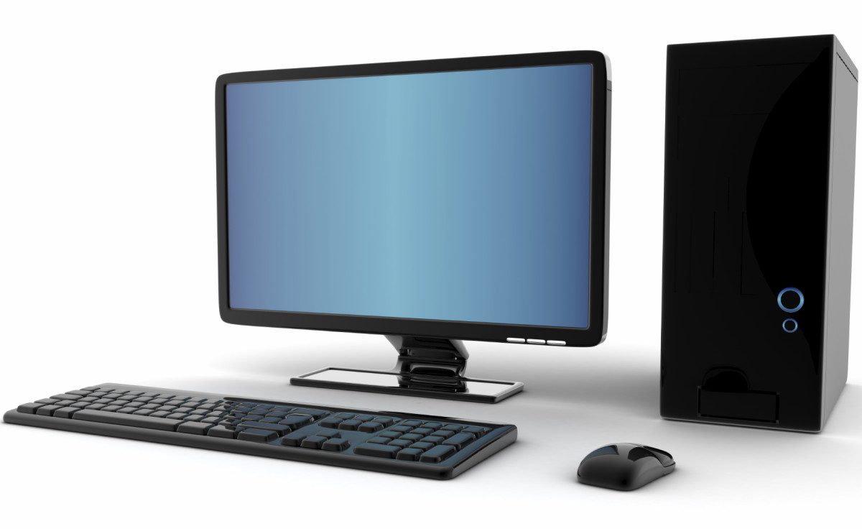

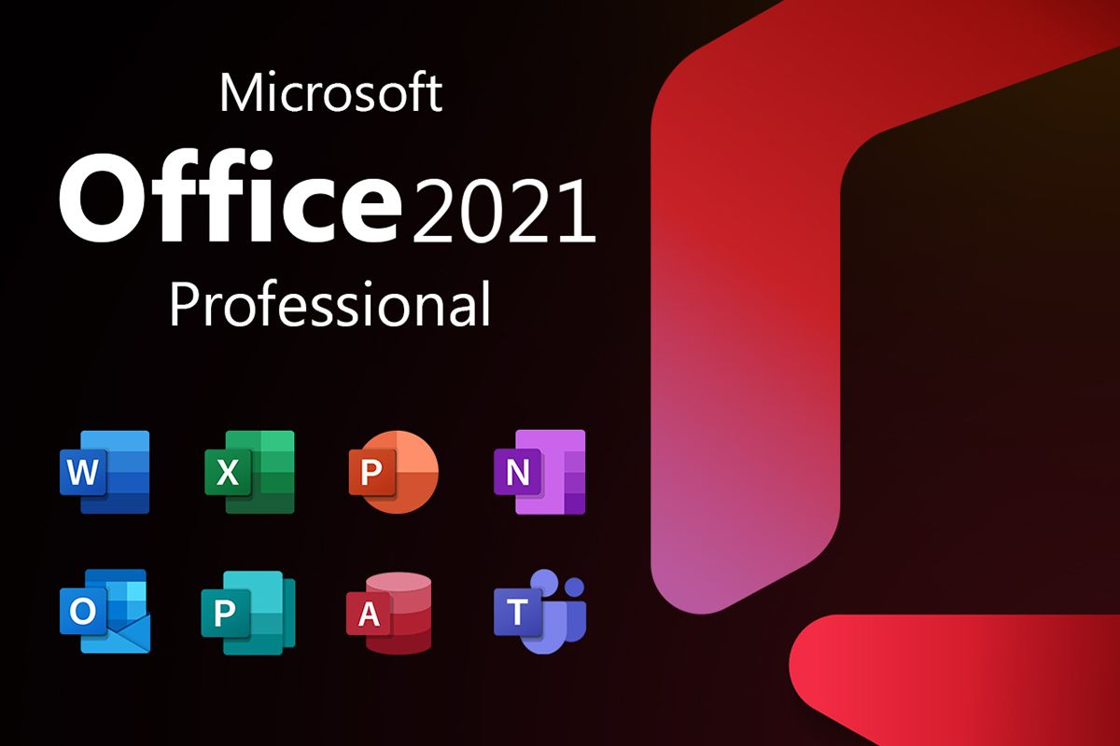
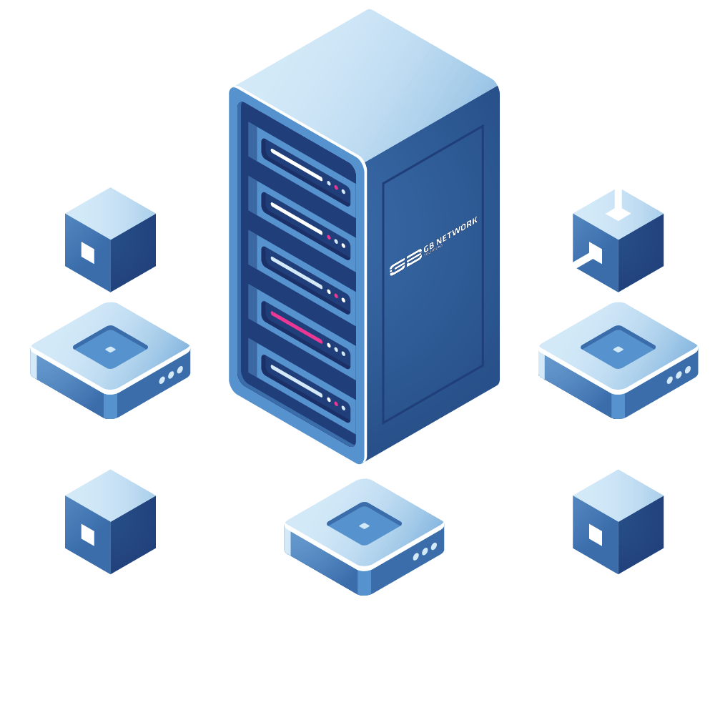


Application Scenario
Windows
General user
Watching video
Visit website
Entertainment
Many company develop game adapting Windows
Business user
Provided office & business software
First choice of Server OS
Safety & stability
Suitable for Software Engineer
System Management
Provided tools and Library related open source
AI, Big Data Analysis
Desktop Computer
Computer Game
Business
Server
Development Environment
Computing
Notes:
https://www.makeuseof.com/practical-applications-of-linux/
https://www.edureka.co/blog/linux-vs-windows/
https://www.wgu.edu/blog/5-most-popular-operating-systems1910.html

Slide 11
Application Scenario
Linux
General user
Watching video
Visit website
Entertainment
Many company develop game adapting Windows
Business user
Provided office & business software
First choice of Server OS
Safety & stability
Suitable for Software Engineer
System Management
Provided tools and Library related open source
AI, Big Data Analysis
Desktop Computer
Computer Game
Business
Server
Development Environment
Computing
Notes:
https://blog.csdn.net/bestboyxie/article/details/52810044
https://blog.csdn.net/hsuehgw/article/details/129443184?spm=1001.2101.3001.6650.3&utm_medium=distribute.pc_relevant.none-task-blog-2%7Edefault%7EYuanLiJiHua%7EPosition-3-129443184-blog-52810044.235%5Ev36%5Epc_relevant_default_base3&depth_1-utm_source=distribute.pc_relevant.none-task-blog-2%7Edefault%7EYuanLiJiHua%7EPosition-3-129443184-blog-52810044.235%5Ev36%5Epc_relevant_default_base3&utm_relevant_index=4

Slide 12
THANK YOU
Windows vs. Linux
(Group 1 Q & A)

